Slide 1




The LoveLincsPlants Project has been made possible thanks to funding from the National Lottery Heritage Fund in partnership with the following:
Notes:
Introduce yourself.
Introduce the Lincolnshire Wildlife Trust.
Introduce subject of this assembly.
Talk about plants and how interesting and important they are to all our lives.

Slide 2




Question 1. What do you already know about plants?
Think about what you would say if an alien asked you to describe a plant.

Slide 3
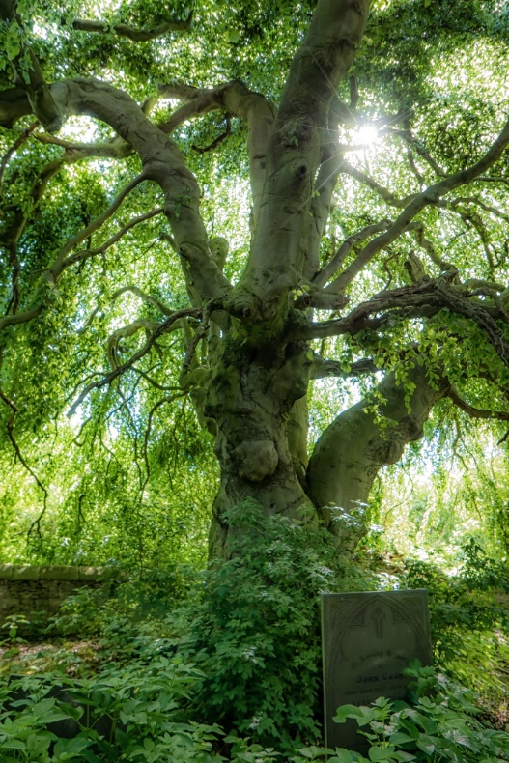
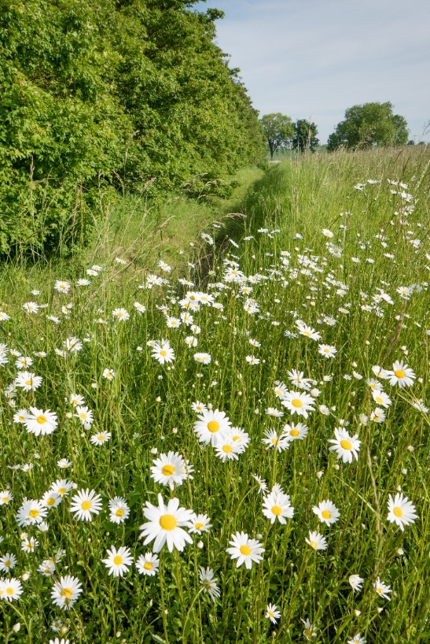
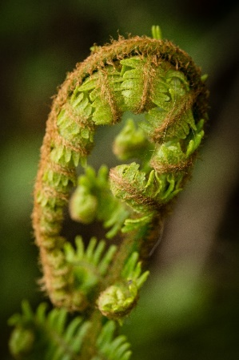
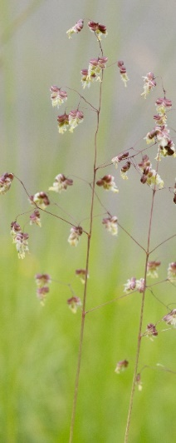
What is a Plant?
Photo: Sarah Lambert
Photo: Sarah Lambert
Photo: Sarah Lambert
Photo: Sarah Lambert
Notes:
A living organism eg trees, shrubs, herbs, grasses, ferns, and mosses.
Usually grow in one place – don’t walk/move/fly around like animals, birds, insects.
Absorb water and minerals through roots. Synthesise nutrients in its leaves by photosynthesis using the usually green pigment chlorophyll.

Slide 4

Question 2.
What are the different parts of a tree called? Name as many as you can.
Picture: Free for reuse from Pixabay

Slide 5
Parts of a tree
Leaves
Twigs
Crown
Branches
Trunk
Roots
Picture: Free for reuse from Pixabay

Slide 6
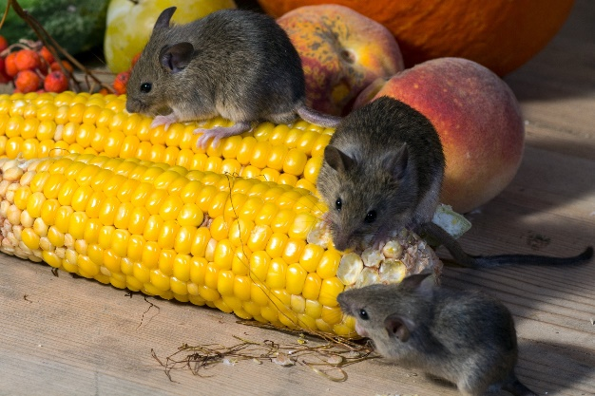
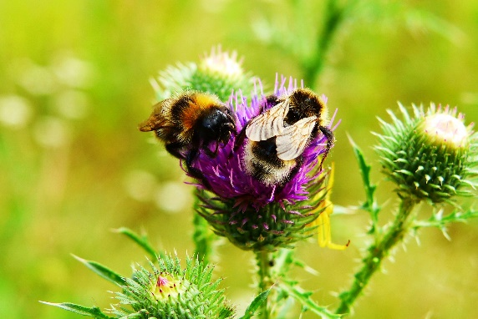
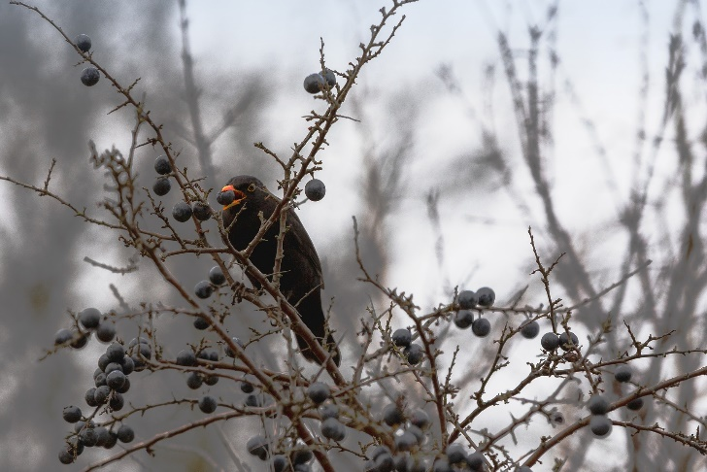
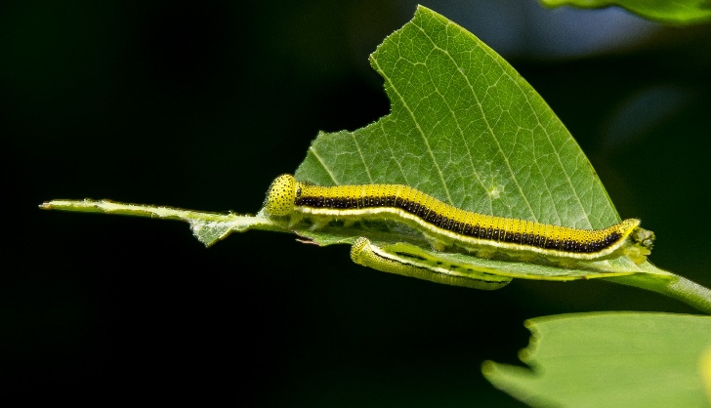
Question 3. Why do you think plants are important for animals, birds and insects?
Photos: Free for reuse from Pixabay

Slide 7




Why are Plants Important?
Photos: Free for reuse from Pixabay
Notes:
Plants are important for animals/insects/birds
What about people?
What do we use plants for?
Food – examples
Clothing – examples including cotton, linen, even bamboo fibres made into fabric
Building materials – examples
Furniture – examples
Fuel – examples including coal/oil plant material from millions of years ago.
Medicine – examples including aspirin from willow bark, drugs for the heart from foxgloves etc 70% of the medicines we use are derived from plants.

Slide 8
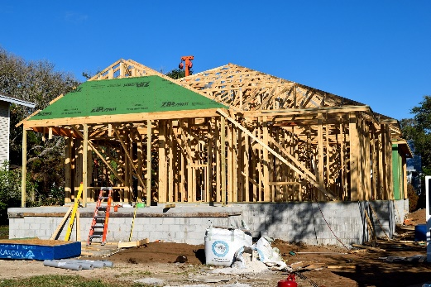
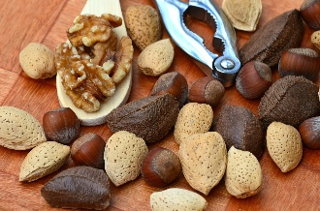
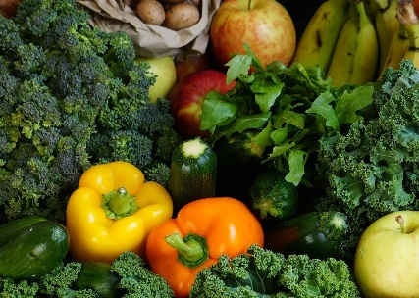
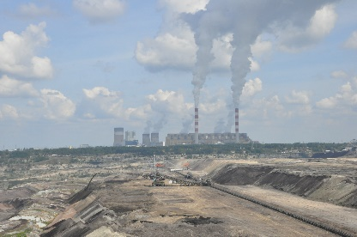
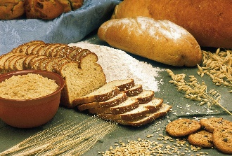
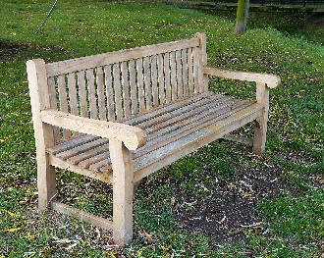
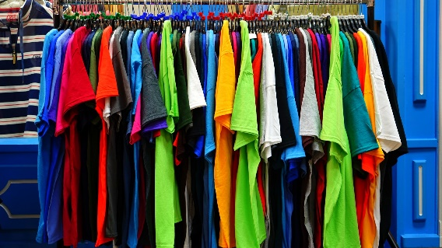

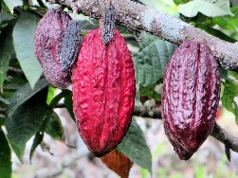
Question 4.
Why are plants so important for people?
Think of the ways we use plants or things we make from them.
Photos: Free for reuse from Pixabay

Slide 9

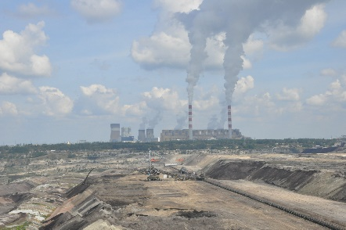






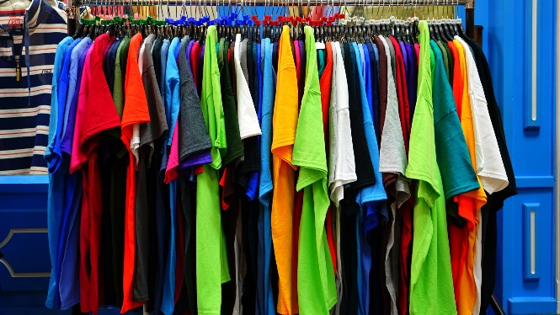
Why are Plants Important for People?
Photos: Free for reuse from Pixabay
Notes:
Food – examples
Clothing – examples including cotton, linen, even bamboo fibres made into fabric
Building materials – examples
Furniture – example
s
Fuel – examples including coal/oil plant material from millions of years ago.
Medicine – examples including aspirin from willow bark, drugs for the heart from foxgloves etc 70% of the medicines we use are derived from plants.

Slide 10
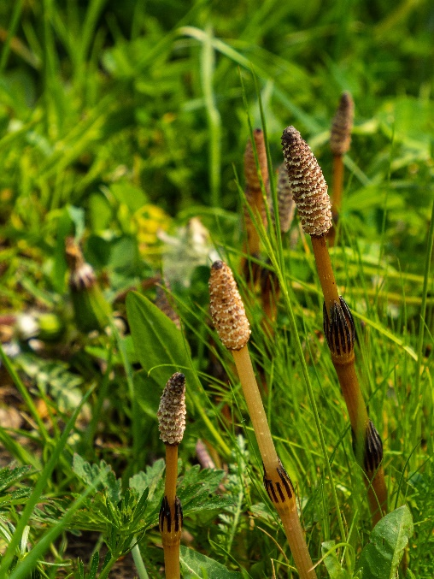
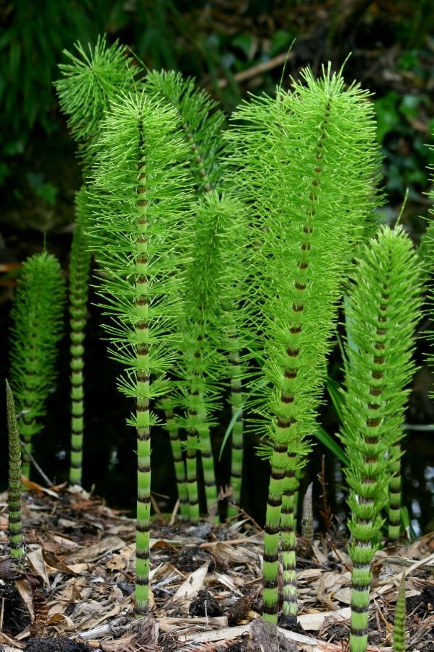
Interesting Lincolnshire Plants
Living Fossils - Horsetails
Photo: Free for reuse from Pixabay
Rror, CC BY-SA 3.0 <https://creativecommons.org/licenses/by-sa/3.0>, via Wikimedia Commons
Notes:
Horsetails – Living fossils have been on the planet for more than 100 million years – older than the dinosaurs.
Also found in fossil record.
Still used in Japan as a very fine sandpaper to finish wooden products as it contains minerals which scour eg silica (ingredient of glass).

Slide 11
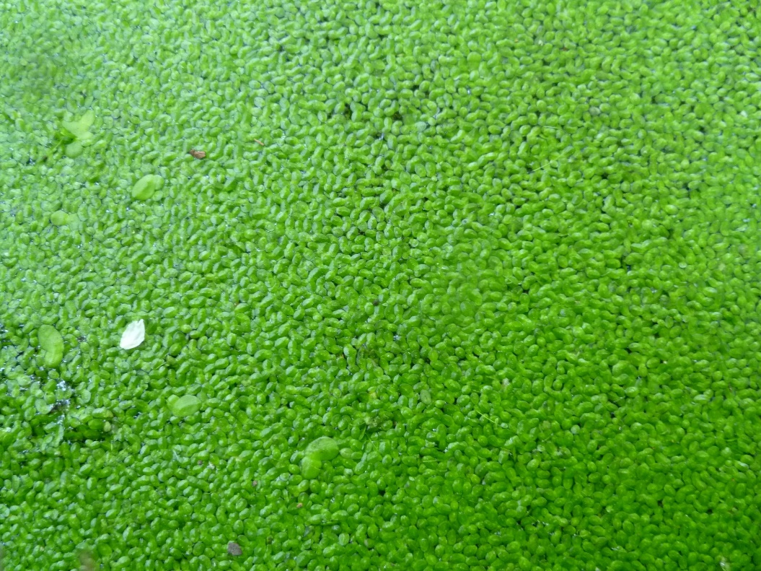
The Smallest Plant
Least Duckweed
Actual Size 0.5mm
About the size of a full stop on an A4 page.
Common duckweed. Photo:Liz Sullivan, CC BY-SA 4.0 <https://creativecommons.org/licenses/by-sa/4.0>, via Wikimedia Commons
Notes:
Least Duckweed Lemna minuta
A very small pond plant. It is very fast growing so this family of plants are often used in scientific experiments. Not native but now found in UK where it is an invasive species.

Slide 12
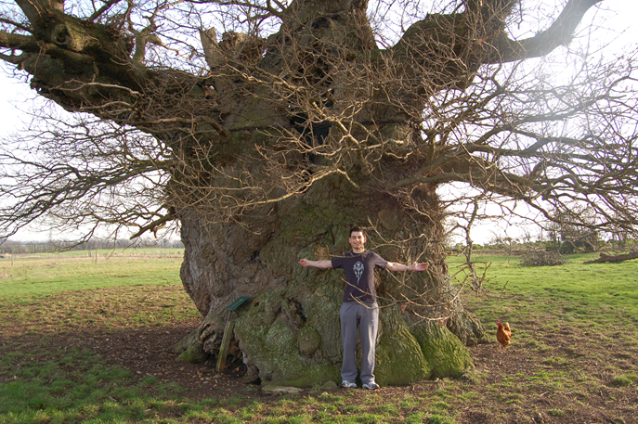
The Largest and Oldest Oak Tree
The Bowthorpe Oak
Photo: Andy Wright, CC BY 2.0 <https://creativecommons.org/licenses/by/2.0>, via Wikimedia Commons
Notes:
Bowthorpe Oak Quercus robour found near Manthorpe, Bourne Lincolnshire
Said to be over 1000 years old. Trunk is now hollow. Circumference is 13.3m which is X children. Diameter is about the length of a car.
1768 the owner George Pauncefoot esq tiled the floor, added a door, roofed it and held dinner parties inside it. A pigeon loft was also built on top of it.
When this tree was an acorn and sapling:
1013 Danish Prince Swein Forkbeard the son of King Harold Bluetooth led an invasion into Lincolnshire, said to have camped in Gainsborough and from there conquered the rest of England.
Then in 1014 he died and was followed by his son Cnut whilst he was at Gainsborough who became king of all England and Denmark.

Slide 13

Question 5.
The trunk of the Bowthorpe Oak measures 13.3m round.
Measure how wide you can spread your arms from fingertip to fingertip. If you and all your class had the same size arms how many of you would be needed to hold hands around the trunk?
Photo: Andy Wright, CC BY 2.0 <https://creativecommons.org/licenses/by/2.0>, via Wikimedia Commons

Slide 14
Question 5.
The trunk of the Bowthorpe Oak measures 13.3m round.
Measure how wide you can spread your arms from fingertip to fingertip. If you and all your class had the same size arms how many of you would be needed to hold hands around the trunk?
Photo: Andy Wright, CC BY 2.0 <https://creativecommons.org/licenses/by/2.0>, via Wikimedia Commons

Slide 15
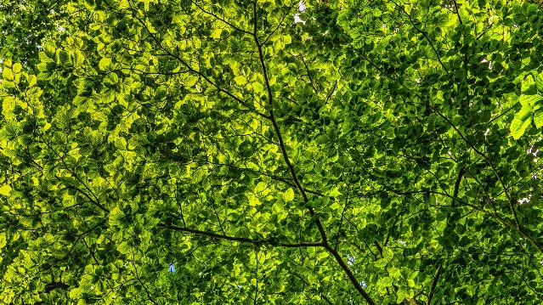
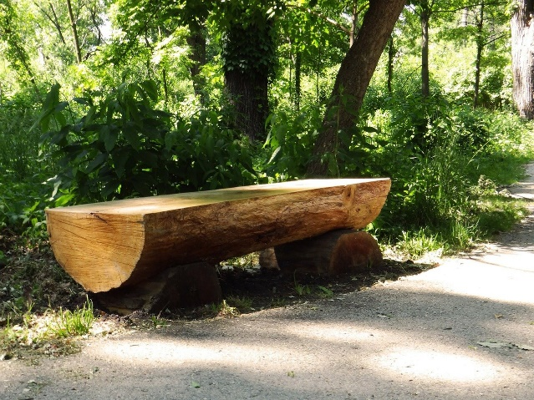

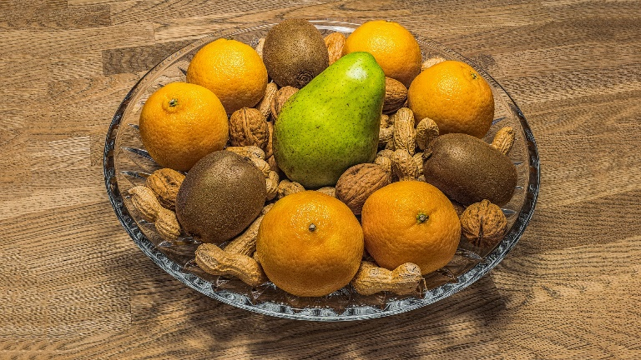
Why are trees so terrific?
Photos: Free for reuse from Pixabay
Notes:
Where would we be without trees? They are a part of our natural global environment, are used to build the very buildings that we live in, and we even write with, eat food from, sit on, and read from products that are made from them.
Because trees are so important, there are many reasons why we should plant more of them. Ask the children for ideas of why they are so important.
(see 20 reasons why trees are terrific for ideas!)

Slide 16
Question 6.
Name some types of tree that lose their leaves in the autumn and are bare in winter.
Name some types of tree that have green leaves in the winter.

Slide 17
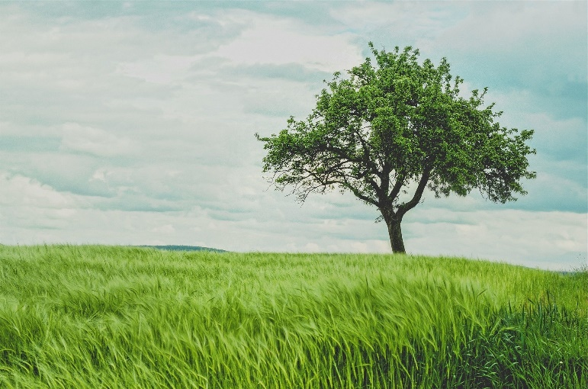
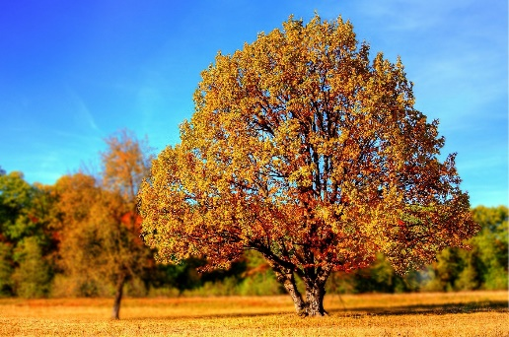
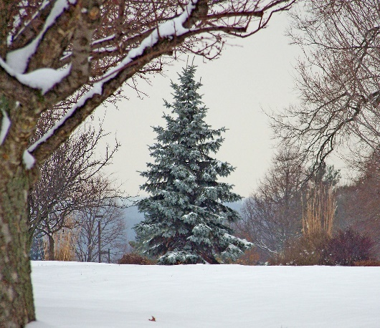
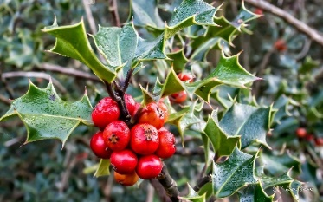
Different tree types
Deciduous trees lose their leaves in autumn.
The leaves change colour and fall to the ground.
New leaves grow in the spring.
Evergreen trees do not lose their leaves in autumn.
They stay green all year round.
Photos: Free for reuse from Pixabay
Notes:
Deciduous trees shed their leaves seasonally and evergreen trees keep their foliage throughout the year. Deciduous trees are adapted to tolerate cold and dry weather conditions by shedding their leaves while evergreens do not. Evergreens can survive with low soil nutrients
Can the children name a few?

Slide 18
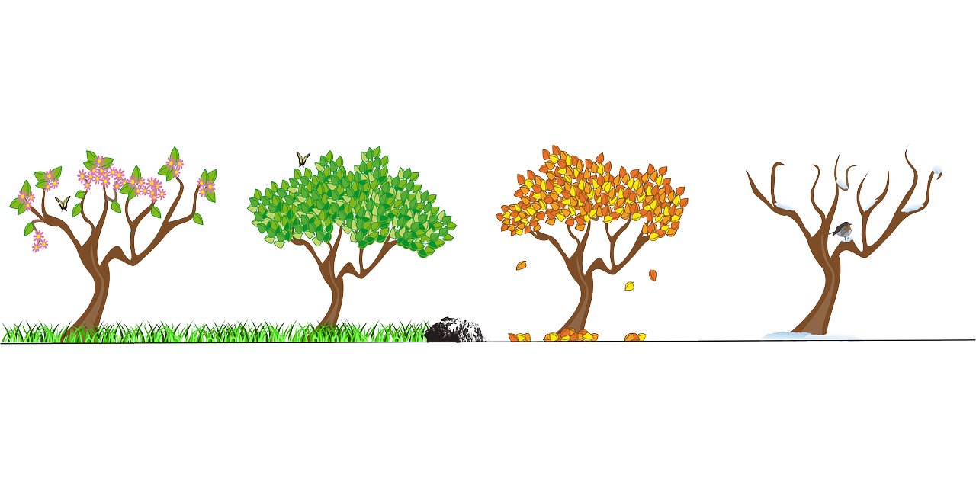
Seasons of a tree
Spring
Summer
Autumn
Winter
Picture: Free for reuse from Pixabay
Notes:
What type of tree helps us understand the seasons? DECIDUOUS
Look at the pictures with them What can they see?
Have they seen any tress in their grounds that look like this?

Slide 19
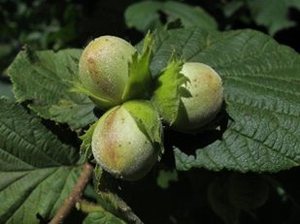
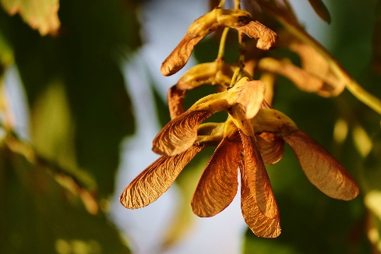
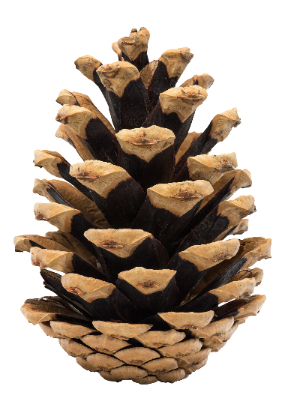
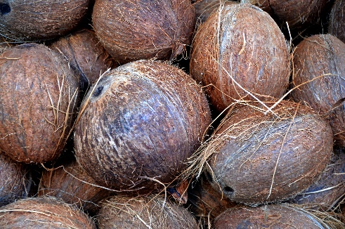
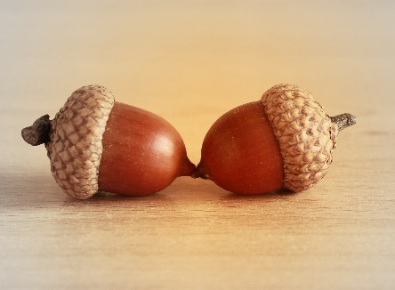
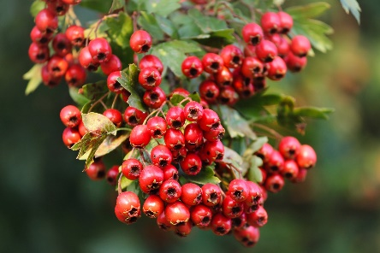
Question 7.
How many different types of tree seeds can you think of?
How do these tree seeds get spread away from the parent tree?
Photos: Free for reuse from Pixabay

Slide 20
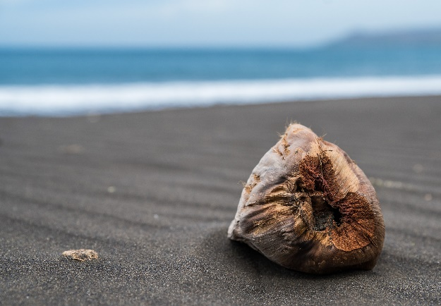
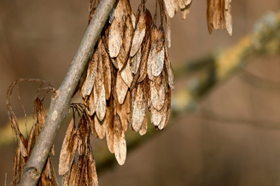
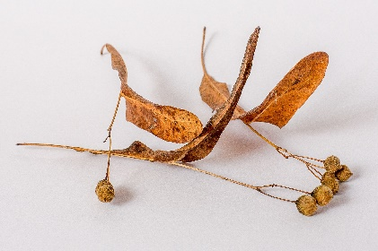
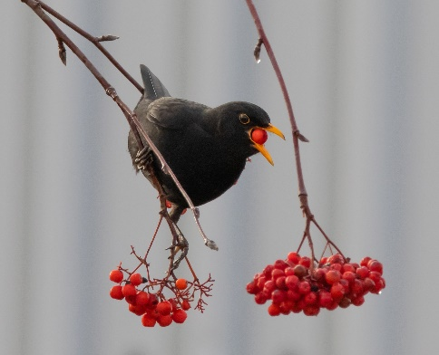
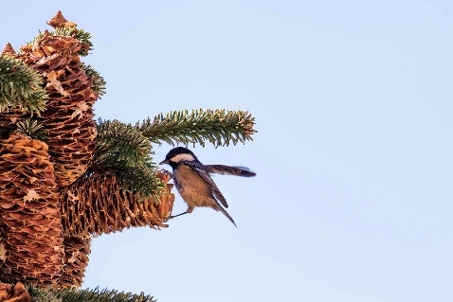
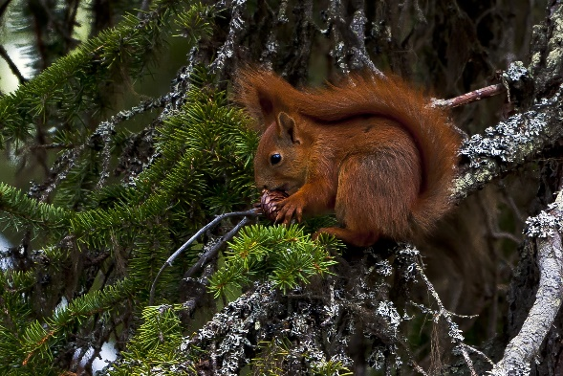
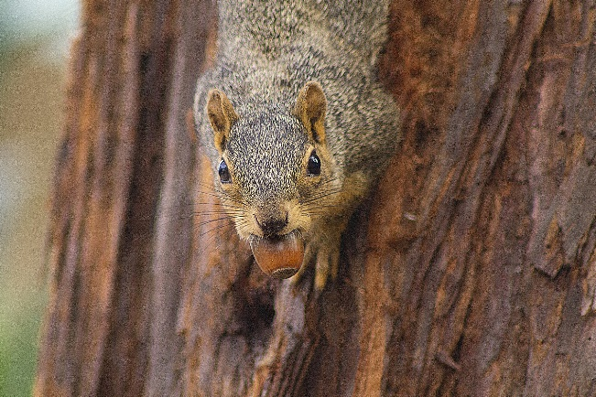
Seeds of a tree- the life cycle
Ash
Coconut
Blown by the wind
Floats in the sea
Small leaved lime
Hawthorn
Pine
Eaten by animals and birds
Oak
Photos: Free for reuse from Pixabay
Notes:
Explain to the children how important the seeds of a tree are in the life cycle and how each one has the potential to be an offspring of its parent and grow into a great tree.
Discuss how different seeds are spread- animal, wind, water, deposits after eating by birds and other animals and why they need to be moved away from the parent due to competition for space, nutrients and water,
Alder seeds can float in water for up to a year and still germinate. Pine seeds can be wind blown as well as eaten by animals and birds

Slide 21
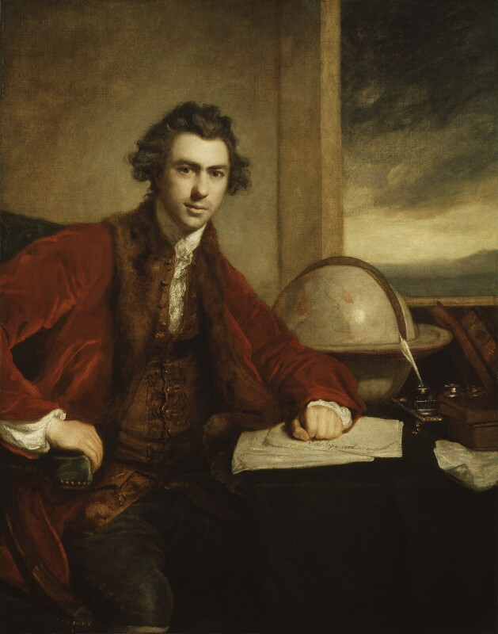
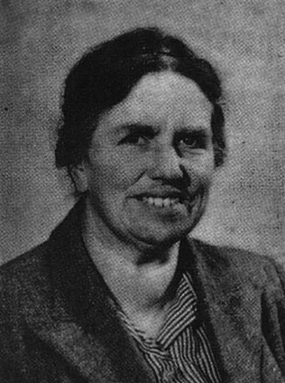
Lincolnshire Plant Collectors
Sir Joseph Banks (1743 – 1820)
E. Joan Gibbons (1902 – 1988)
©National Portrait Gallery, London. www.npg.org.uk
Notes:
Plants - collected by naturalists and scientists for hundreds of years.
Example of collectors
Sir Joseph Banks from Revesby near Horncastle, Lincolnshire (1743 – 1820).
Became interested in botany at school aged 9.
Travelled with Captain James Cook to Australia and New Zealand in 1768 when he was only 25, collecting plants that hadn’t been seen in Britain at that time.
Some specimens held in the NHM, London others at Kew Gardens, London
E. Joan Gibbons from Holton-le-Moor, near Market Rasen, Lincolnshire (1902 – 1988).
Became interested in wildflowers whilst a child and went to her first meeting about wildlife at the age of 11.
Specimens she collected now in the British and Irish Herbarium at Natural History Museum.

Slide 22
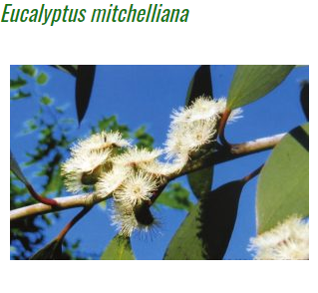
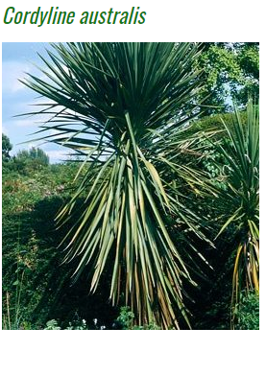

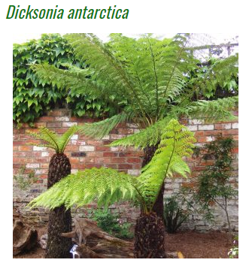
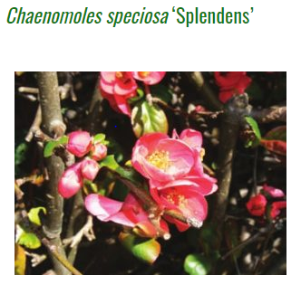
Sir Joseph Banks tree collection
Cabbage Tree
Buffalo Sallee
Soft Tree Fern
Japanese Quince
Photos: www.joseph-banks.org.uk
Notes:
These are all examples found in the Sir Joseph Banks garden in Horncastle, grown from seeds from the time he travelled and brought back plants from his travels.
They may have some examples in their own gardens
Have fun getting them to guess the common name with the Latin name and where they come from.
Chaenomoles speciosa ‘Splendens’
Common Name: Japanese Quince
Family: ROSACEAE
Region: Asia
Dicksonia Antarctica
Common Name: Soft Tree Fern
Family: DICKSONIACEAE
Region: New Zealand & Australia
Cordyline australis
Common Name: Cabbage Tree
Family: ASPARAGACEAE
Region: New Zealand
Eucalyptus mitchelliana
Common Name: Buffalo Sallee
Family: MYRTACEAE
Region: Australia

Slide 23
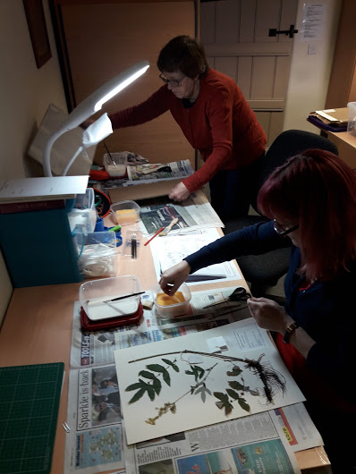



A Herbarium for Lincolnshire in Lincolnshire
Notes:
Collections are called Herbaria.
What is a Herbarium?
A collection of pressed and mounted plants that includes information about when it was collected, where, who collected it, habitat, colour of flower/seeds.
Several herbaria with plants from around the world in the Natural History Museum, London.

Slide 24






A Herbarium of Lincolnshire Plants at the Natural History Museum, London
Notes:
A collection of pressed and mounted plants that includes information about when it was collected, where, who collected it, habitat, colour of flower/seeds.
Sir Joseph Banks Centre, Horncastle
Several herbaria with plants from around the world in the Natural History Museum, London.
Plants are such an important part of our modern world that a lot of research has already been carried out but much more is needed.
Impact of activity is measured using collections of plants collected from hundreds of years ago compared to plants collected now.

Slide 25


The Study of Plants is called Botany
Are You a Botanist of the Future?
Photos: Free for reuse from Pixabay
Notes:
The study of plants is called Botany.
Botany the scientific study of the physiology, structure, genetics, ecology, distribution, classification, and economic importance of plants.
Herbaria are used to compare plants from hundreds of years ago with plants collected recently. The DNA or genetic make-up can be studied to look for changes. The active substances that form the basis of medicines are also studied to see if they can be used to cure more or different diseases.
Collections of plants can also be used to show which plants have become extinct over time, which plants have spread and which plants are more or less common.
Plants are really interesting and vitally important to life on earth.
On your way home from school, in your garden or in the playing field see how many different plants you can find and all the different places that plants can live. Some of them may be really small and in tiny cracks, others may be very large like trees.

Slide 26



Thanks for watching!
For more information on the LoveLincsPlants Project and for school resources, go to:
www.lincstrust.org.uk/love-lincs-plants

